Slide 1
REVIEW 1
PERIOD 2
GV: Trần Ngọc Thảo Nguyên
Lớp: 3A2
Ngày 07 tháng 11 năm 2024

Slide 2
1. Warm-up
Whispering game

Slide 4
2. Read
and
match.

Slide 5
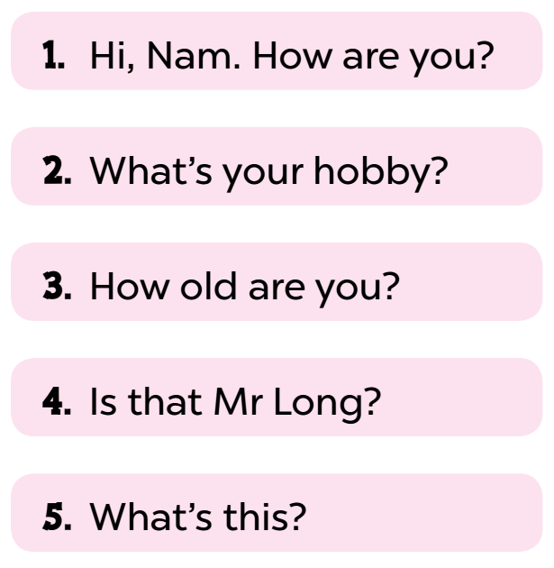
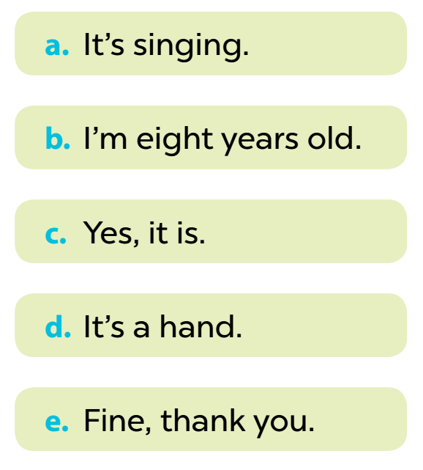

Slide 6
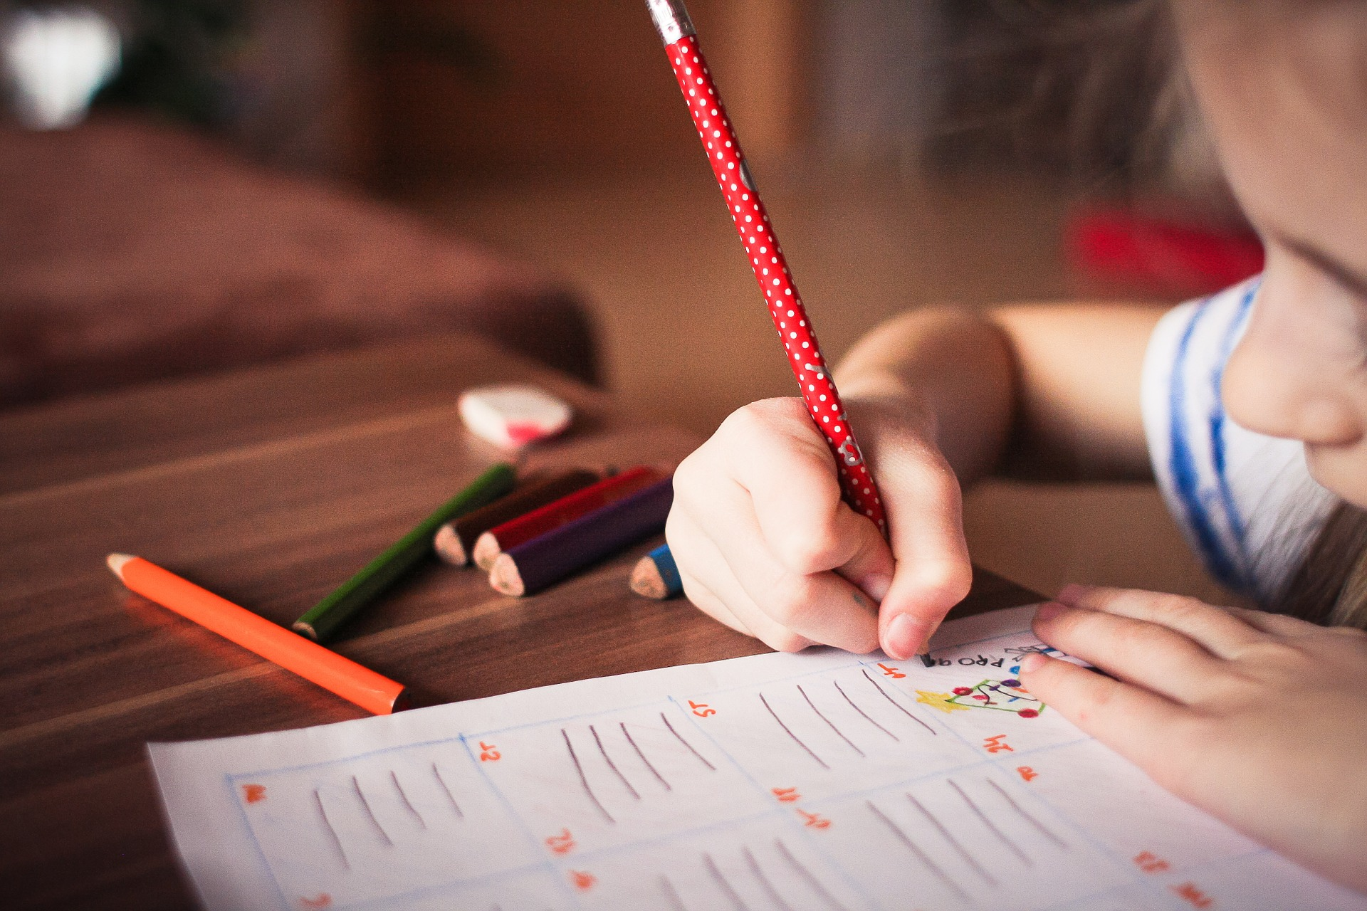
3. Read
and
complete

Slide 7
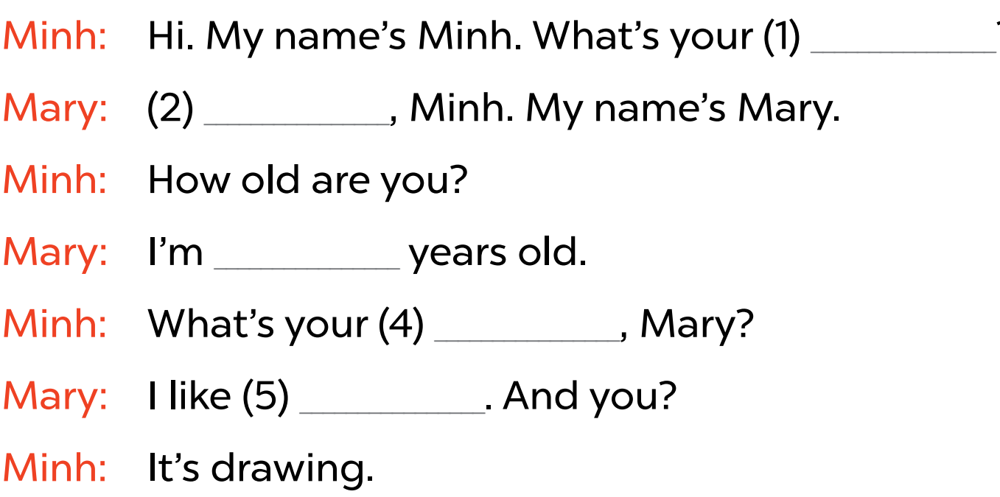
name
?
Hello
eight
hobby
singing

Slide 8
How many people are there
in the conversation?
2 people

Slide 9
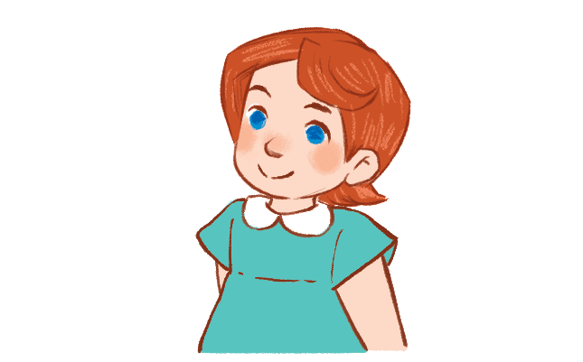
What is Mary’s hobby?
She likes
singing.

Slide 10
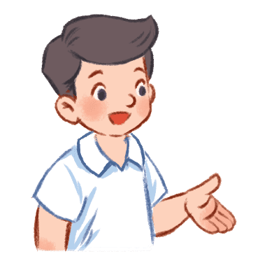
What is Minh’s hobby?
He likes
drawing.

Slide 11
4. Ask
and
answer.

Slide 13
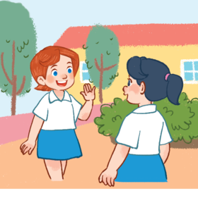
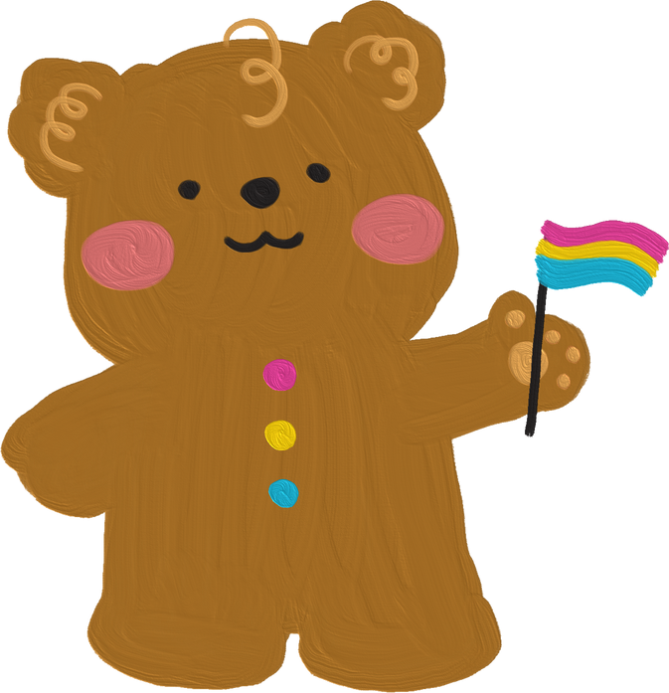
How are you?
Fine, thank you.

Slide 14
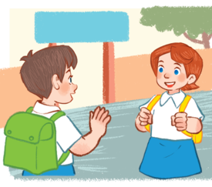
What’s your
name?
My name is ...
I’m ...

Slide 15
How old
are you?
I’m ... years old.

Slide 16
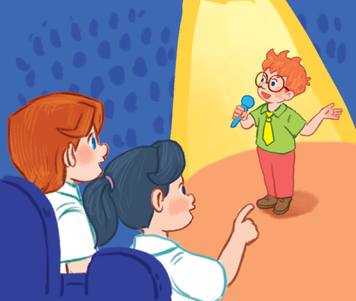
What’s your
hobby?
It’s ...
I like ...

Slide 17
Game time!
Notes:
Quiz game
- Pupils use their mini board to write A in one side and B in the other side.
- Teacher asks pupils look at the question and choose the correct answer in only 10 seconds. Then hold up their board to answer A or B.

Slide 18
What’s your name?
A
B
My name’s
Hoa.
Hi Ms.Hoa!

Slide 19
How old are you?
A
B
I’m nine
years old.
I’m fine.
Thank you.

Slide 20
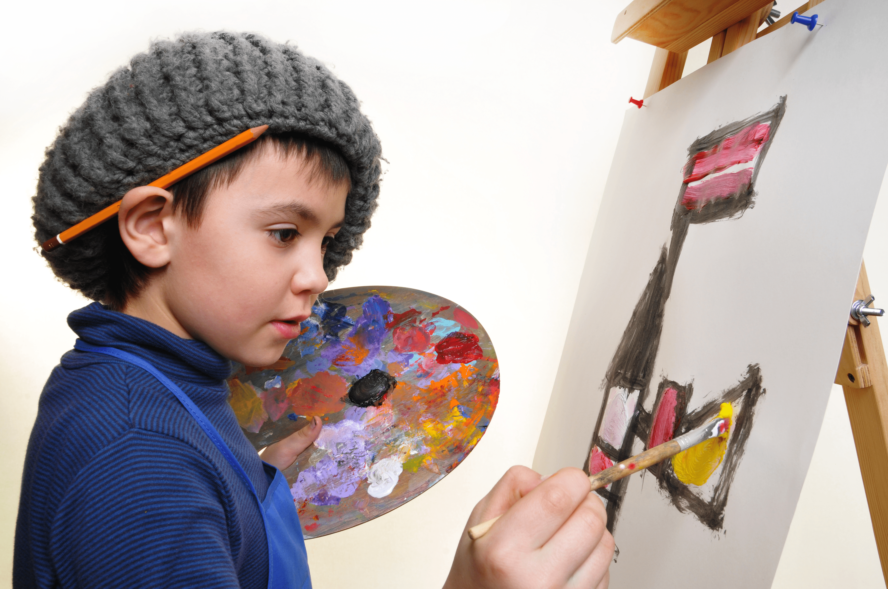
What’s your hobby?
A
B
It’s Ben.
It’s drawing.

Slide 21
Thank you !

