Slide 2
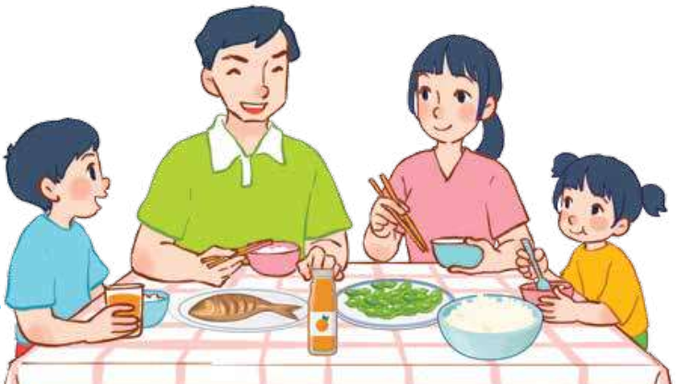
15
At the dining table
LESSON 3 – PERIOD 5
Date: 18/03/2025

Slide 3
At the dining table
Warm up
& review
Listen and tick.
Fun corner
& wrap up
Listen and repeat.
Let’s chant.

Slide 4
TIC TAC TOE
Warm up
& review

Slide 5
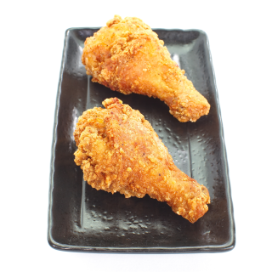
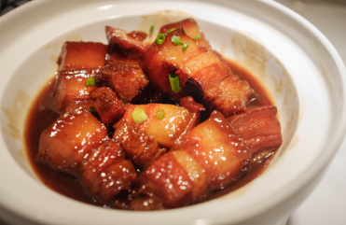
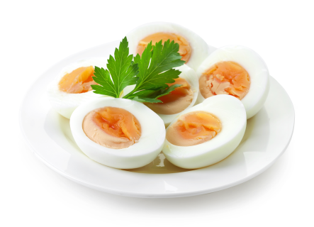
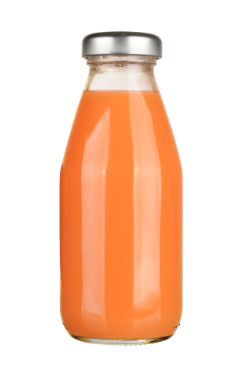
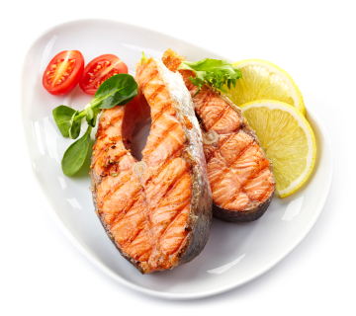
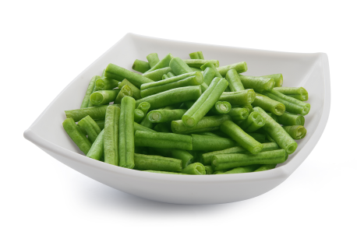
Choose and say!
I would like some…….

Slide 8
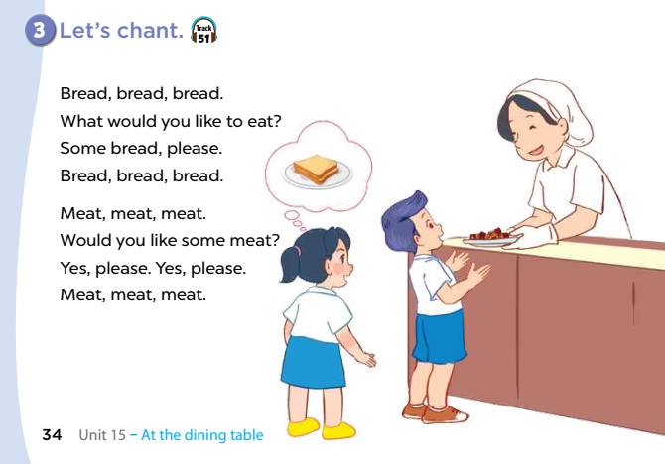

Slide 9
Extra stuffs

