Slide 1
WELCOME TEACHER TO OUR CLASS!

Slide 2
CLASSROOM RULES

Slide 3
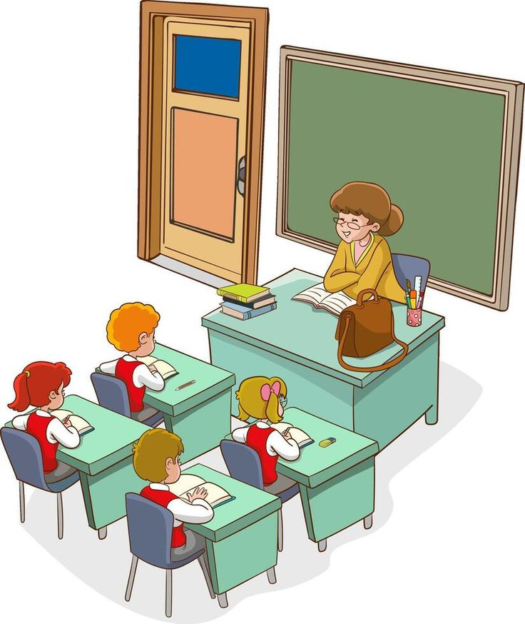


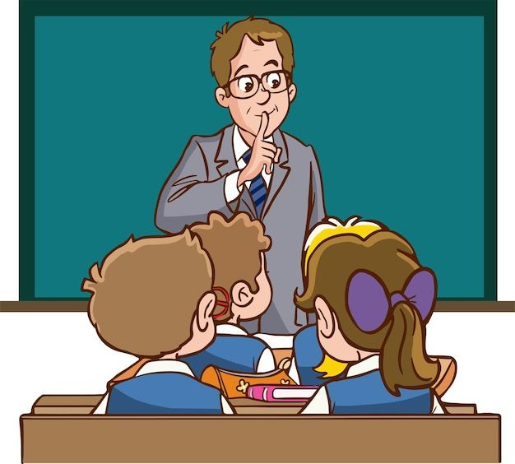
01
Sit nicely.
02
Be quiet!
03
Listen to teacher.
04
Raise your hands.

Slide 4
01
Warm-up and review

Slide 5


Our Sports Day
9
Lesson 2 – Act 1-3
Date: 17/12/2024

Slide 6





Slide 7
02
Look, listen and repeat.

Slide 8
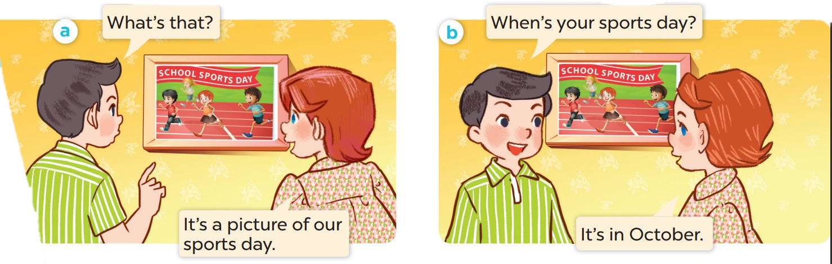
Who is the girl? Who is the boy?
Where are they ?

Slide 9

Look, listen and repeat.

Slide 10
Work in pairs. Practise.

Slide 11
03
Listen, point and say.

Slide 12
Structure
Hỏi bao giờ đến ngày hội thể thao của bạn ?
When’s your sports day?
It’s in_______
Khi nào đến ngày hội thể thao của bạn?
Nó vào tháng _____

Slide 13
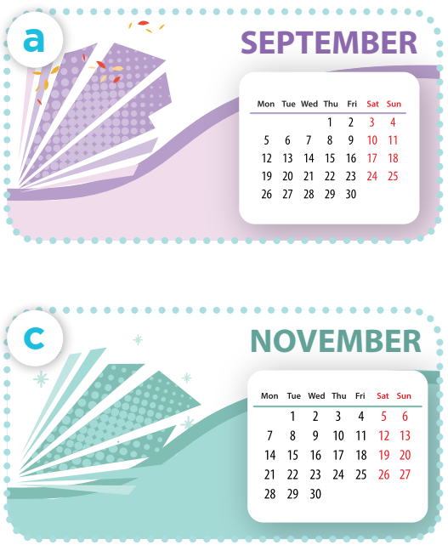
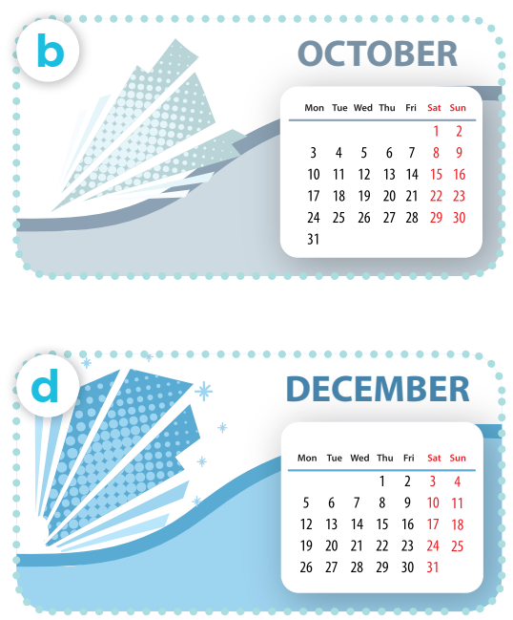
Listen, point and say.
Work in pairs. Practise.
When’s your sports day?
It’s in ___.
Notes:
Click on the Speaker Icon to play the audio.

Slide 14
04
Let's talk.

Slide 15
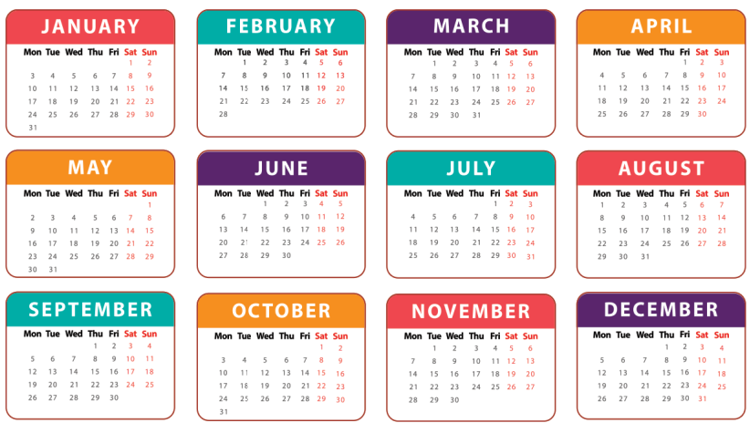
When’s your sports day?
It’s in ___.

